Slide 1
Pharmacy Management Project
Saravanan Ramamurthy
Dedalus
sramamurthy7@dedalus.com
9841345710

Slide 2
AGENDA
Introduction​
Environment Setup
Workflow
​Features
​​

Slide 3
Introduction
Pharmacy Management Project mainly used to save the drug master and the patient dispensing system in JSON format.
Main purpose of this project is to showcase or explore the Angular features taught during training period

Slide 4
Environment SETUP

Slide 5
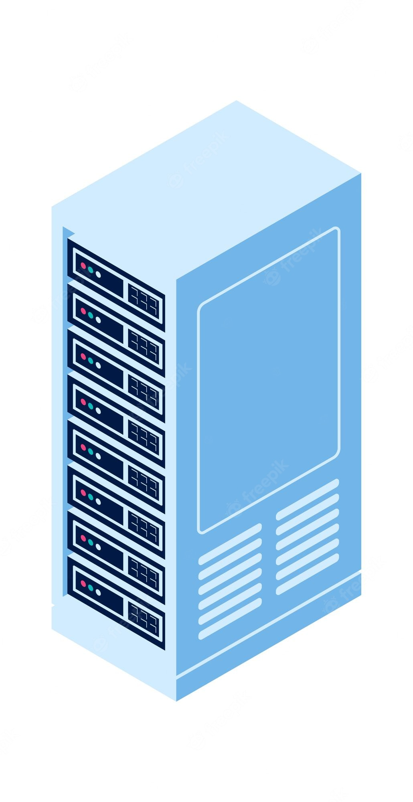
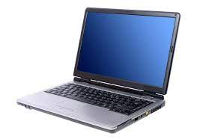

Environment SETUP
Images
Nginx Server
http://localhost:8081/
Data
json-server-auth
json-server-auth --port 4500 data.json
http://localhost:4500/
Output – Browser
http://localhost:4200/
Development Laptop

Slide 6
Workflow

Slide 7
Login
Register user
Admin 0r
User
Admin
User
Admin module
User module
DispenseList BoxComponent
DrugComponent to save Drug Detail
DispensingComponent
List down the Dispensing saved using user type User
DispensingBoxComponent
DrugBoxComponent
for Listing
List down the Dispensing saved using user type User
Logout

Slide 8
Features

Slide 9


Lazy LOADING
Login is an entry page that requires user identification and authentication, regularly performed by entering a username and password combination.
Lazy loading is a technology of angular that allows you to load JavaScript components when a specific route is activated. It improves application load time speed by splitting the application into many bundles.
Login component decides the login person is administer or user type. Based on the type of user the specific route will be activated.
Admin login saratest1@gmail.com
User login saratest2@gmail.com

Slide 10
Template Driven Form
A template-driven form is the simplest way to build a form in Angular. It uses Agular's two-way data-binding directive (ngModel) to create and manage the underlying form instance.
Login component , new drug creation forms and new dispensing creations forms are based on template-driven form in this project.
we need to specify behaviors/validations using directives and attributes in our template form .

Slide 11
Built IN DIRECTIVES and INPUT VARIABLE
Built in directives and INPUT variable are used in the project to pass the communication between parent and child component and modify the template.
Drug service boxes and Dispensing service boxes are dynamically created using built in directive ngFor
Built in Uppercase pipe is used to display the Drug code, Drug Name, Patient Prn and Patient name in capital .

Slide 12
THANK YOU

